Slide 1
Materials Selection and Sustainability
Notes:
This work is licensed under the Creative Commons Attribution-NonCommercial-ShareAlike 4.0 International License. To view a copy of this license, visit http://creativecommons.org/licenses/by-nc-sa/4.0/.

Slide 2
Why is materials selection so important?
Notes:
Open up for classroom discussion. Encourage students to discuss their rationale and give examples
Talking points: properties for the application, price, environmentally friendly materials, etc. – Good iClicker or PollEverywhere question if using

Slide 3
Thought Experiment
Need to design a bicycle frame
Notes:
Next few slides are leading students through a thought experiment on designing a bicycle frame for two different purpose bikes.
The goal is to have students realize that there isn’t always just ONE material that fits for a single application.

Slide 4
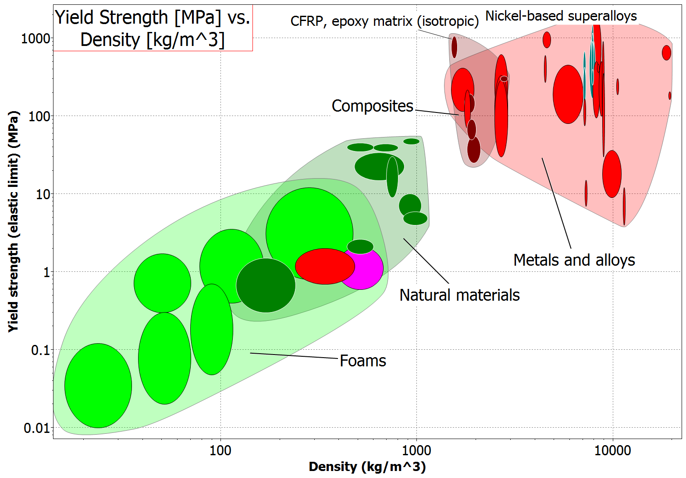
Increasing Strength
Increasing Density
Figure from CES Edupack Software
Notes:
Ashby diagram showing yield strength vs. density. and how composite materials allow us to have an increase in strength without as much increase in density or weight as traditional metals

Slide 5
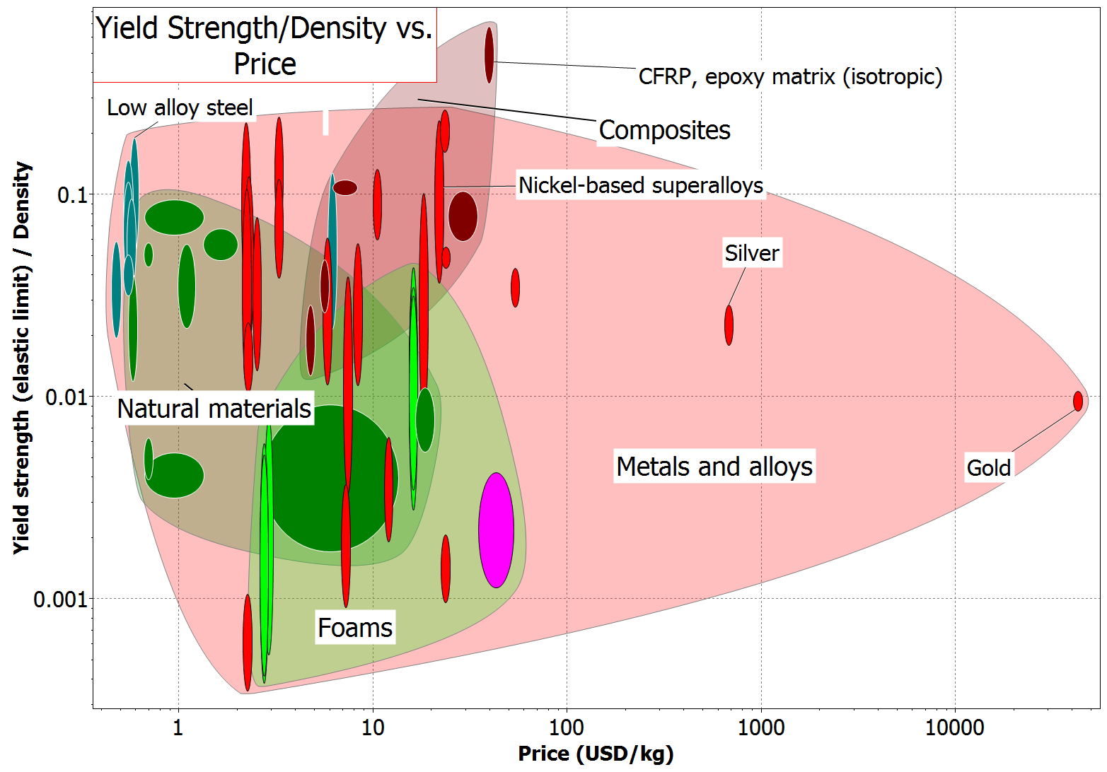
Increasing Strength
Increasing Price
Figure from CES Edupack Software
Notes:
Now comparing metals to composites in strength vs. price. Notice how composites are much more expensive

Slide 6
What material class would you choose when making a children’s bike?
Notes:
Which material class would you choose if you were making a children's bike?– good polling question. Answer? A lightweight steel that is strong but cheap
Have students think back to their bikes as kids/bikes they see in their neighborhoods. Comment on facts like children outgrowing bikes quickly, so they shouldn’t be expensive

Slide 7
What material class would you choose if you were making a racing bike?
Notes:
Which material class would you choose if you were making a racing bike? Answer: composites that allow much higher strength, where price isn't an issue but weight is.
Talk about the Tour de France or other competitive bike racing. Would they care about price? Or would they care more about weight?
Wrap up this section highlight how important considering a wide range of factors is when designing objects, including final user of said product.

Slide 8
Sustainable Materials Design
Take into account more than just technical design parameters
Notes:
Switching gears to talking about specifically sustainable materials design

Slide 9
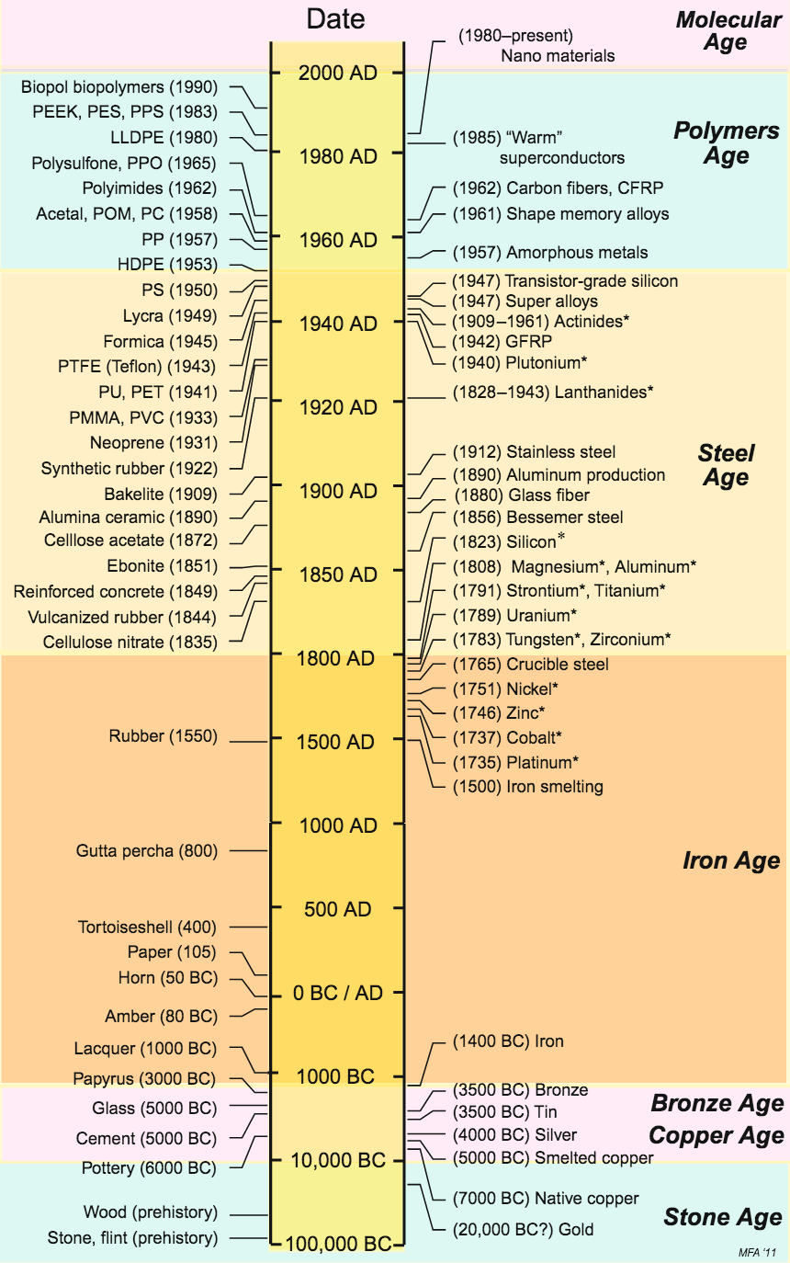
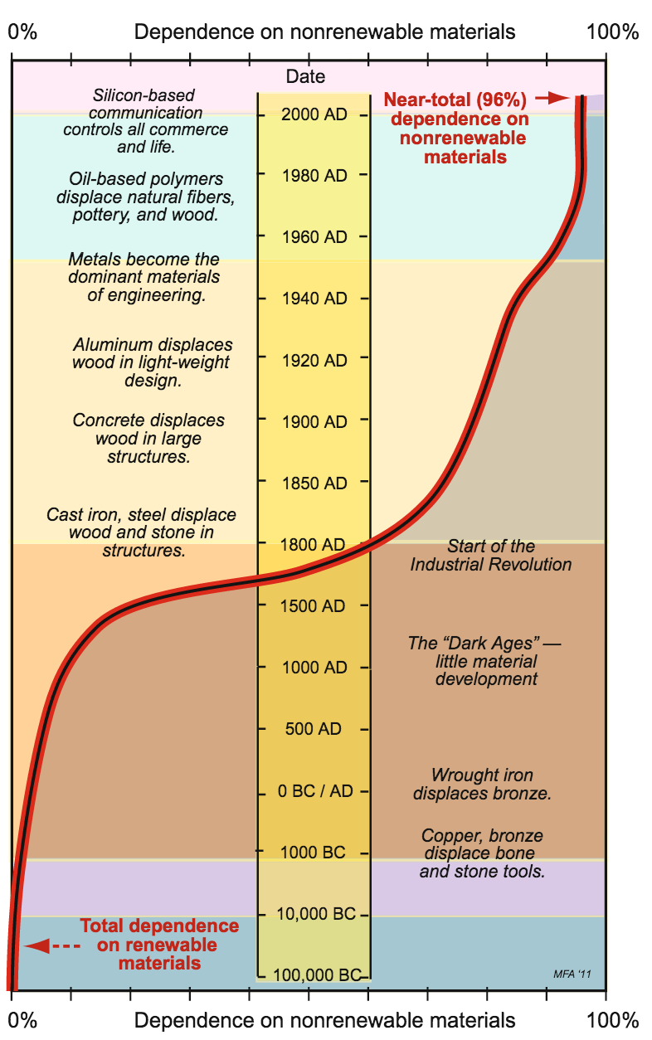
Notes:
These graphs showcase how the materials we use today, while highly technologically advanced, are nonrenewable. As engineers, it is important for us to make environmentally conscious decisions

Slide 10
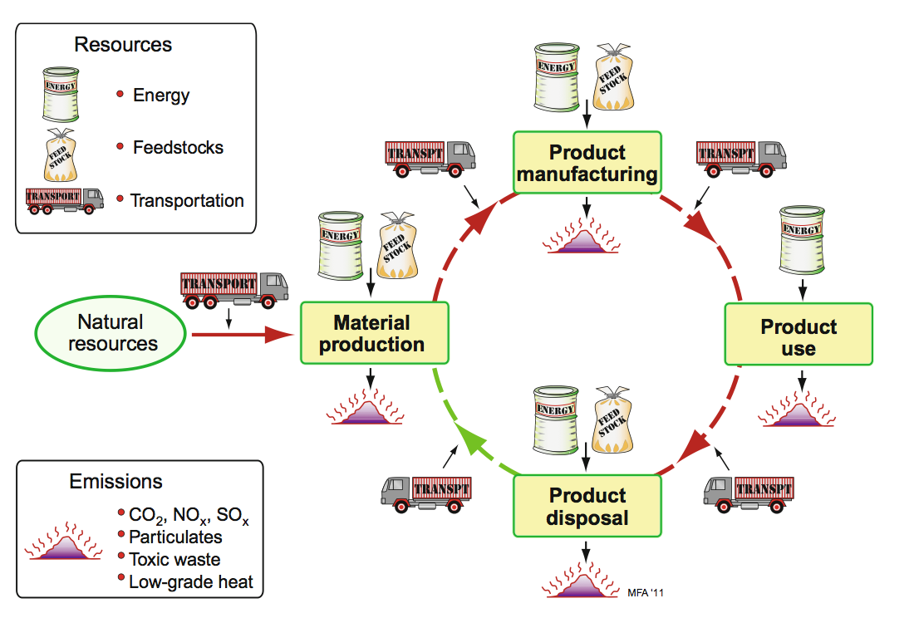
Materials Life Cycle
Figure from MSE 489 Slides/CES Edupack Resources
Notes:
Highlight where energy is required during different aspects of making and using materials for different products. Can give examples of glass vs. plastic bottles (plastic takes more energy to make and is more difficult to recycle, but is much lighter to transport than glass)

Slide 11
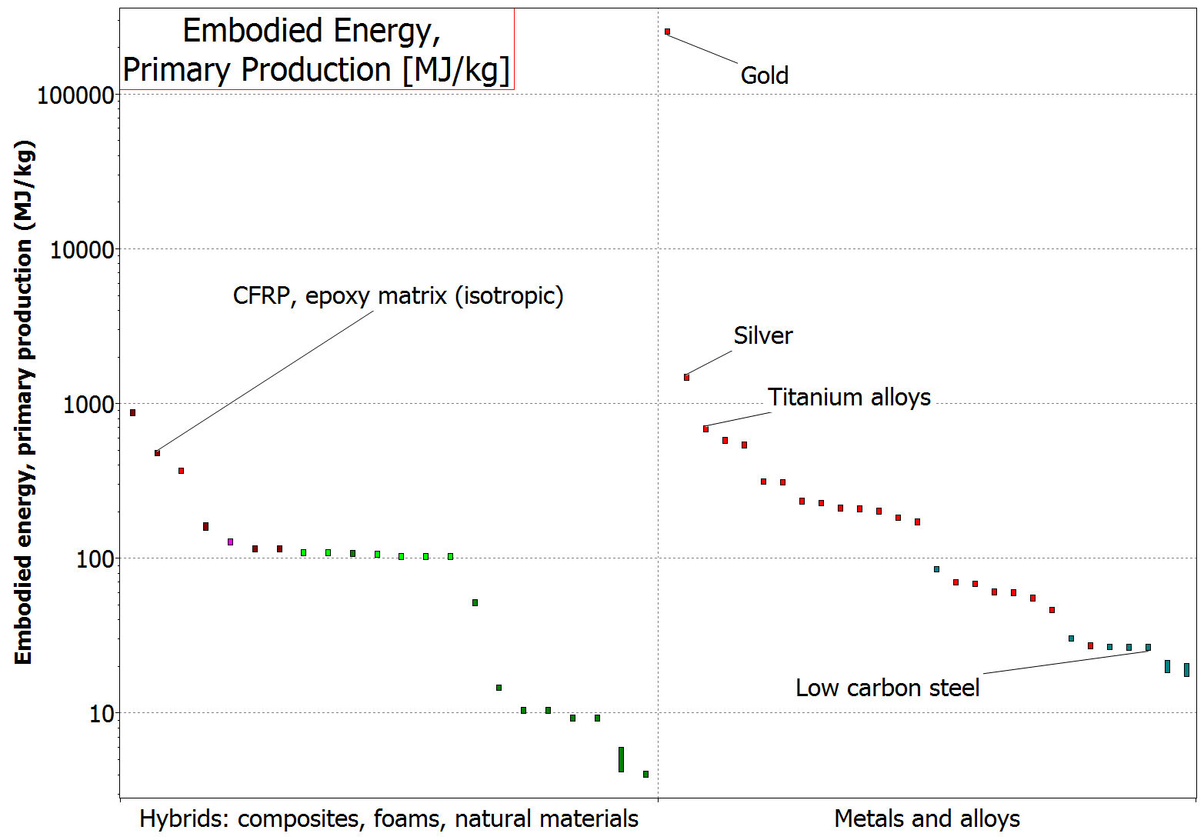
Figure from CES Edupack Software
Notes:
Showing the energy required for production of materials, such as Carbon Fiber Reinforced Composites (CFRP) and low carbon steels

Slide 12
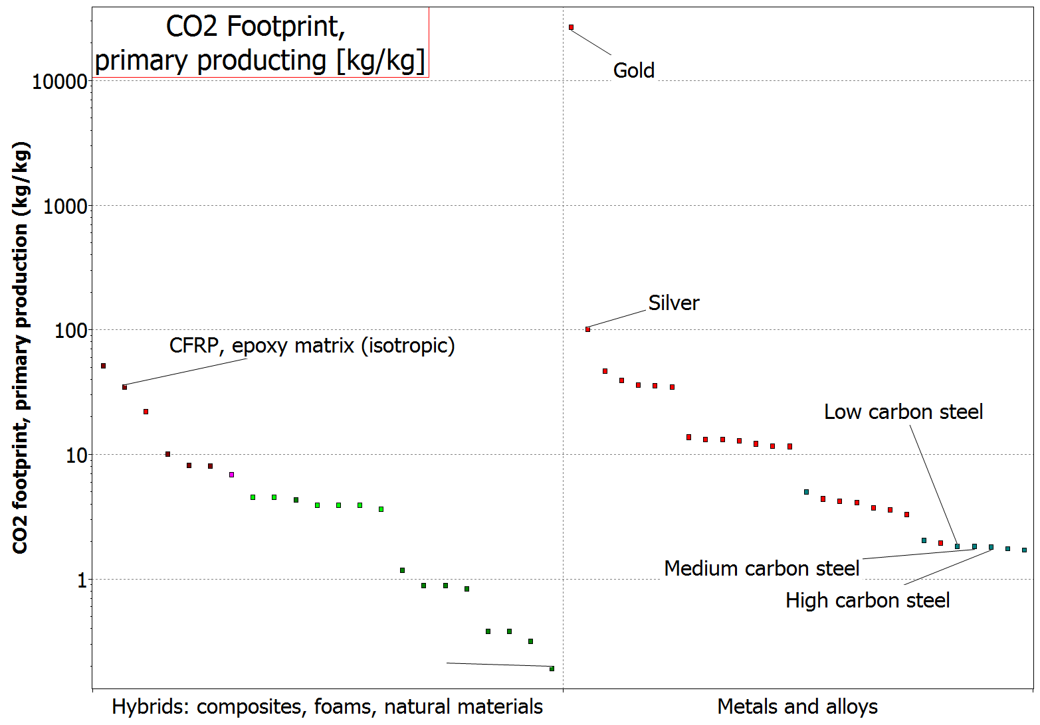
Figure from CES Edupack Software
Notes:
Showing the difference in CO2 footprint for composites and low carbon steel

Slide 13
Does your vote for best material change for….
The racing bike?
The children's bike?
Discuss!

Slide 14
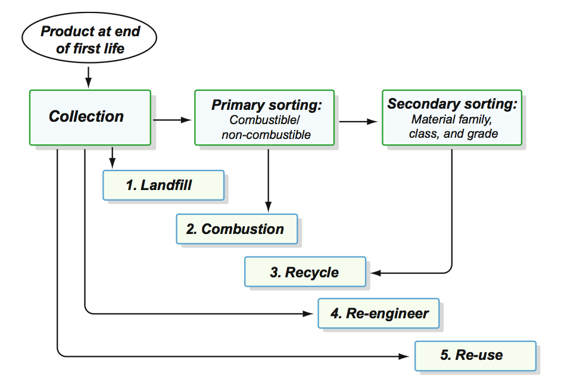
End of Life
Landfill: immediately removed from product chain
Combustion: Burn items to create energy via heat
Recycle: Recovering material to return it to use stream
Re-engineer: Replacing parts of a complex system to extend life
Reuse: redistribute product to consumers either for original purpose or different
Notes:
Different options for materials at the end of life. Encourage students to think of different materials they know of that could fit in these categories.

Slide 15
Recycling
https://youtu.be/b7GMpjx2jDQ
Notes:
Link to a 8:54 minute Scishow video on how recycling works

Slide 16
Additional Questions to Consider
How much energy does it take to create the material?
Can the material easily be recycled?
Can the item easily be disassembled to reuse/recycle materials?

Slide 17
Activity
Split into 4 groups
Each group will be in charge of designing an object
First design best for constraints you come up with
Do not forget to use your common knowledge when picking your materials!
Then check and see if your material is Eco Friendly
15 minutes– discuss and chose materials
5 min– present to class

Slide 18
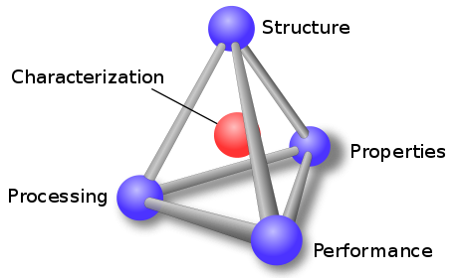
Where does this fit on our tetrahedron?
Notes:
Materials selection involves all portions of the tetrahedron. Have students discuss what they think before revealing the answers.

