Slide 1
Composites

Slide 2
What is a composite?
Can you think of any composites that you might use every day?
Notes:
What is a composite? Can you think of any composites that you might use every day?
https://www.polleverywhere.com/free_text_polls/ZYuZRfIPrRuC8Sl

Slide 3
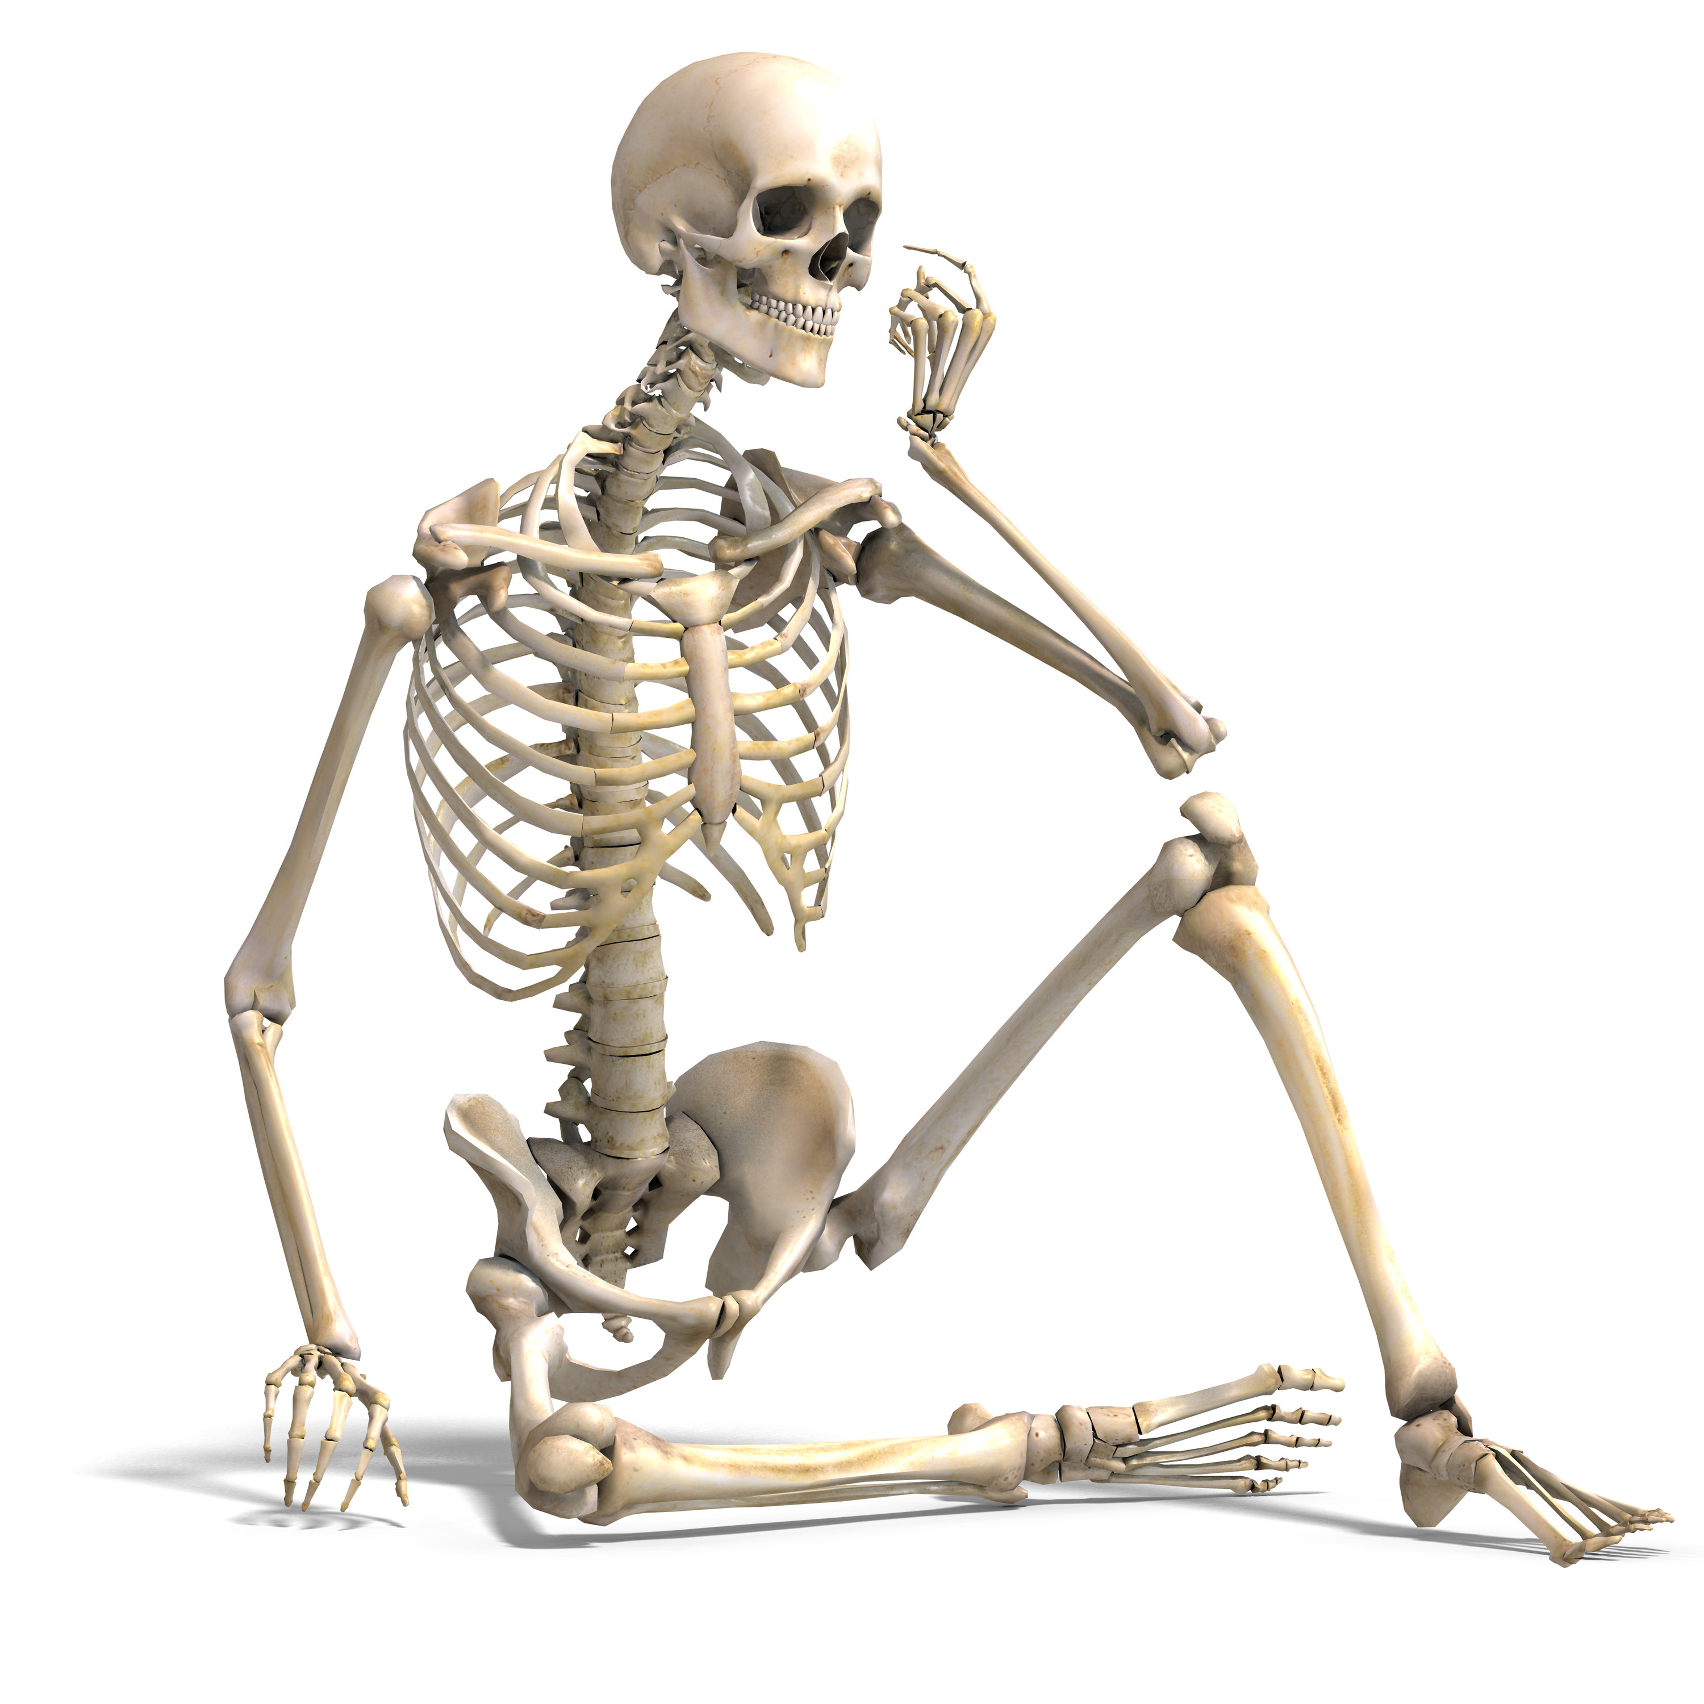
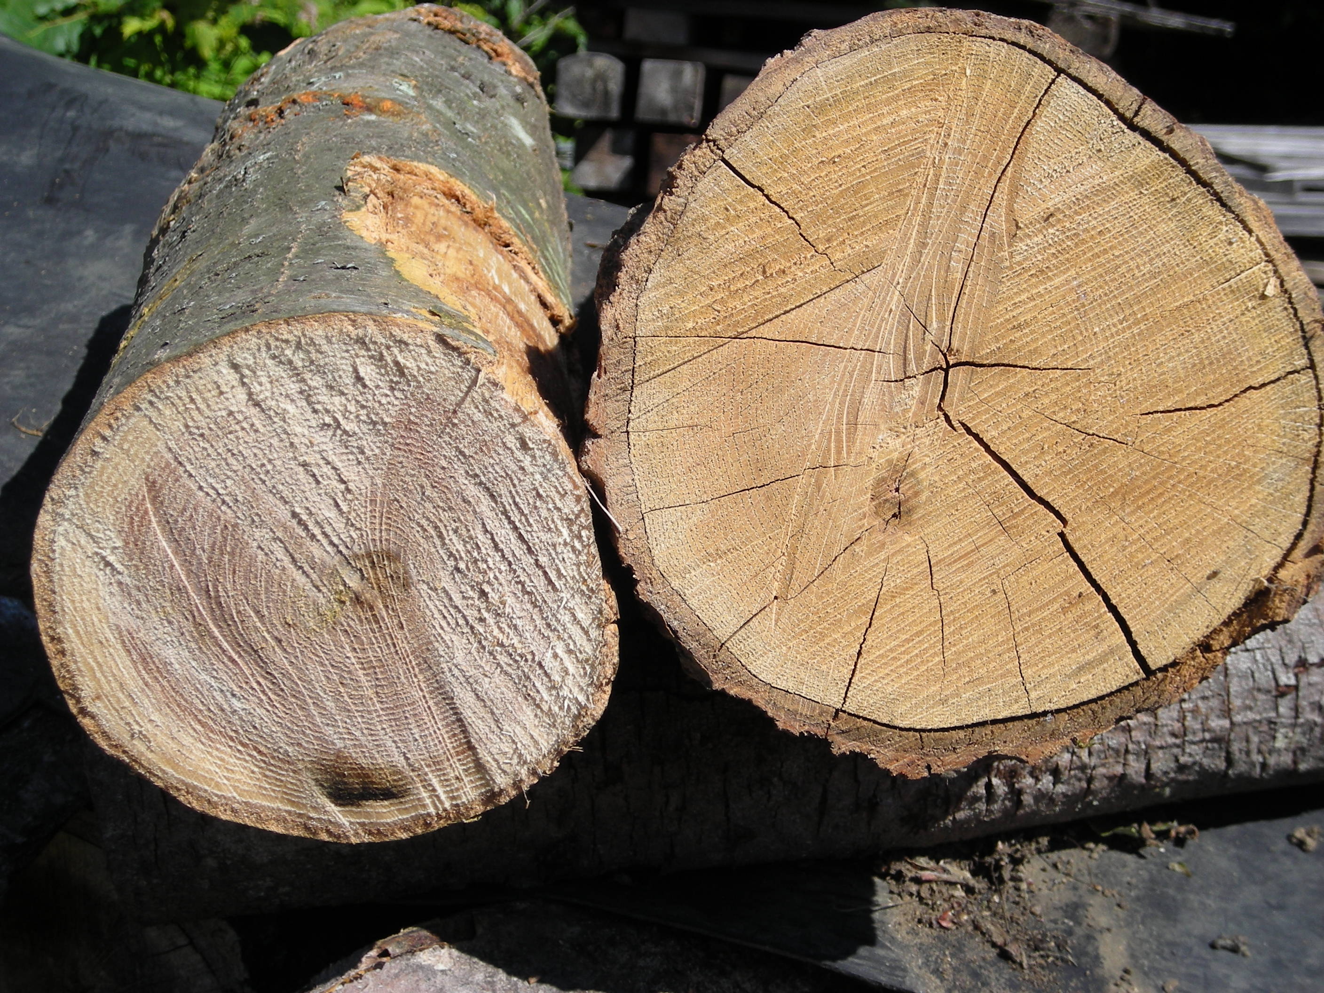
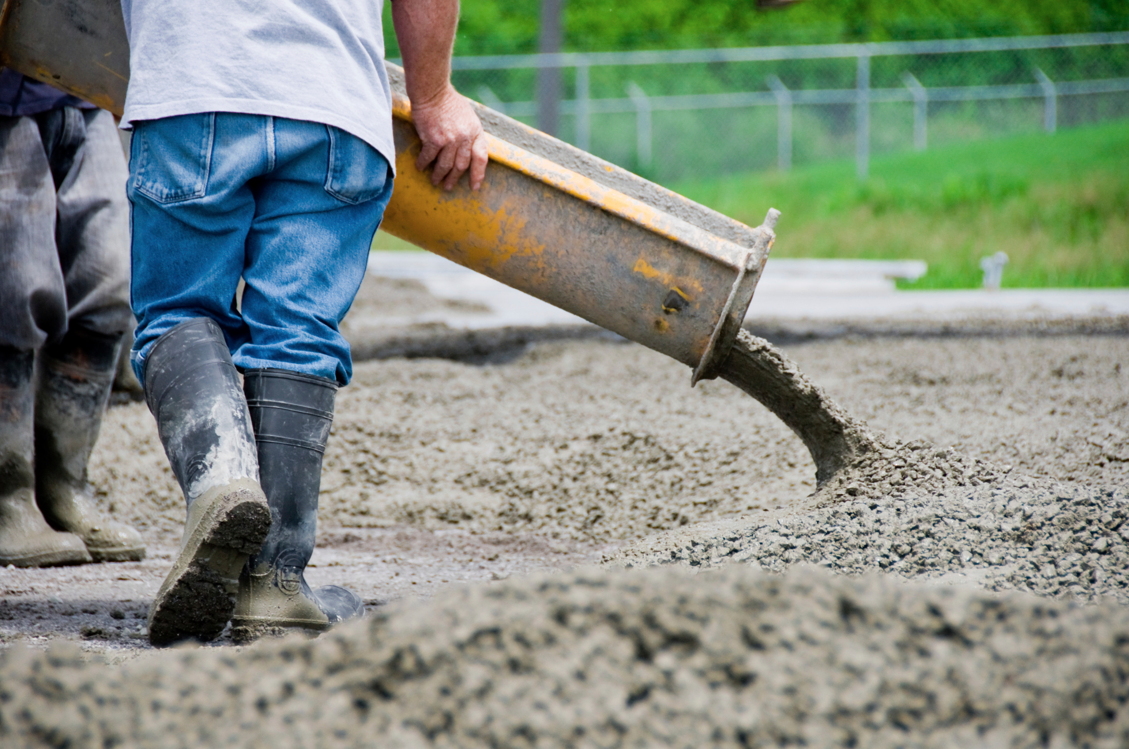
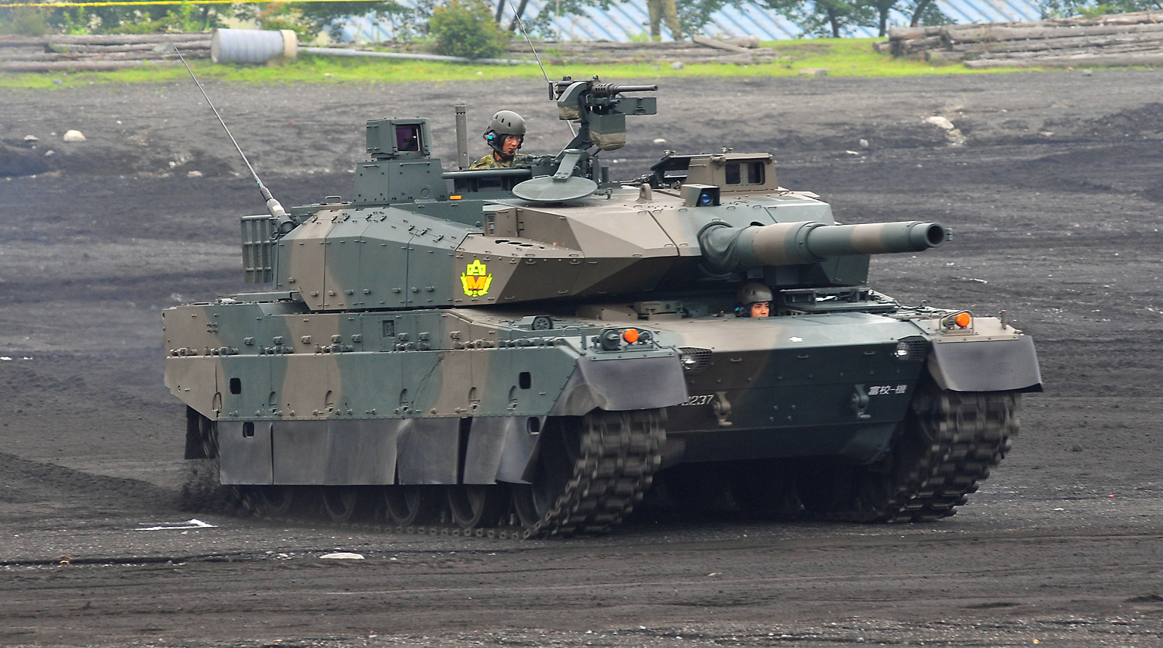
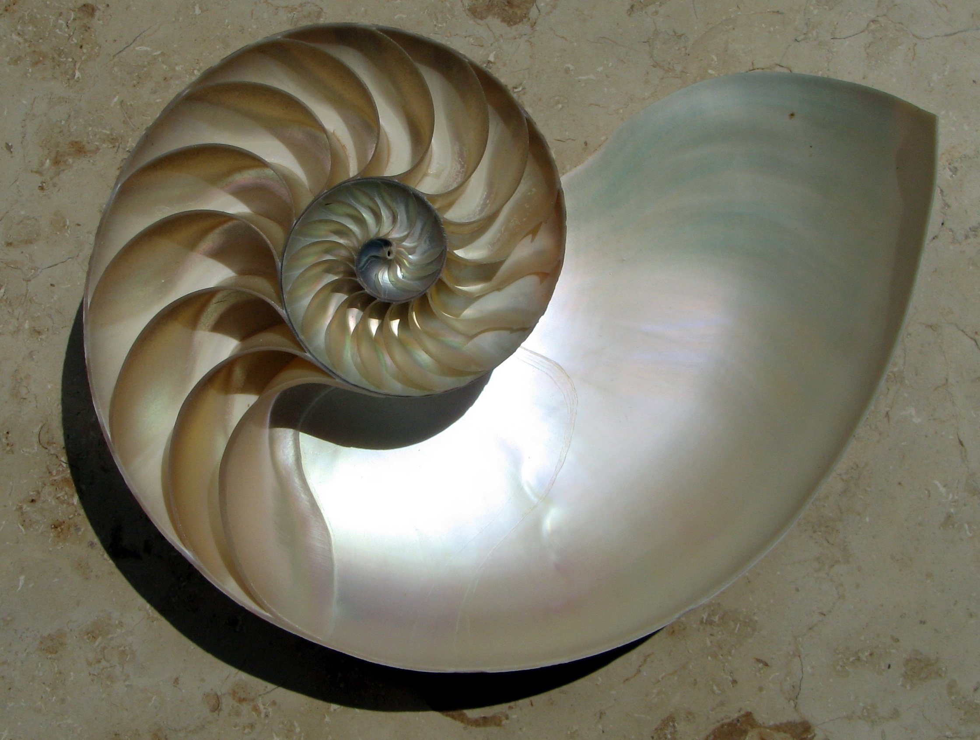
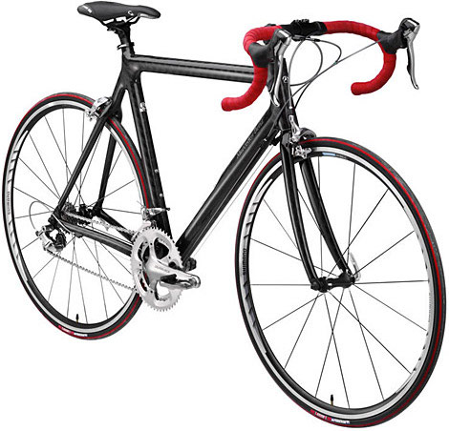
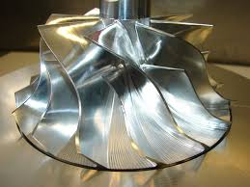
What is a composite?
Notes:
These examples include both natural and engineered composites that students may be familiar with from their everyday lives. Bone, wood and nacre (the seashell) are all natural composites that combine stiff and compliant materials to improve durability and maximize functionality.
The engineered composites include concrete (cement + gravel), polymer-based carbon-fiber composites (bicycle, plane and wind turbine) and metal matrix composites (the turbine and tank applications).

Slide 4
Composites combine properties not found in a single material

Slide 5
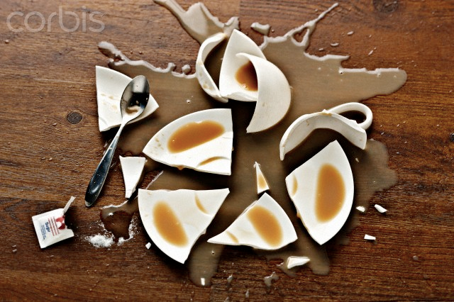
How do we define strength and toughness?
Strength: high resistance to deformation
Toughness: high resistance to fracture

Slide 6
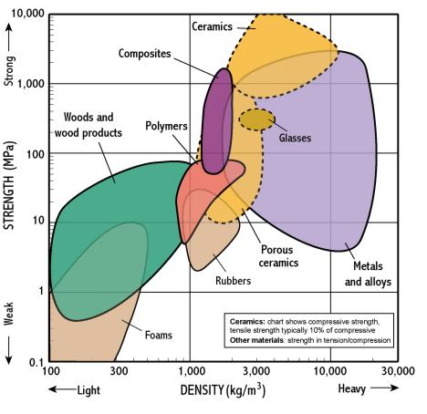
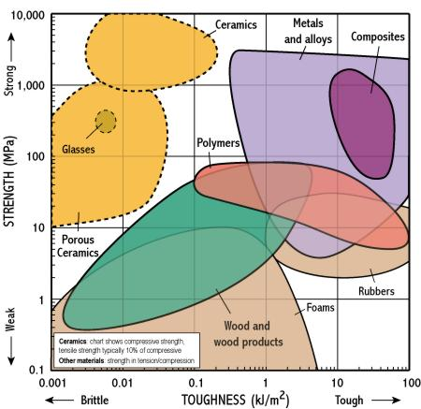
For example:
Notes:
These Ashby plots compare the properties of strength vs. density (specific strength) on the left and strength vs. toughness on the right. Toughness defines a materials resistance to crack or fail while strength defines a materials resistance to deformation or change in shape.

Slide 7
Why is the specific strength of ceramics so much higher?
Notes:
Why is the specific strength of ceramics so much higher?
https://www.polleverywhere.com/free_text_polls/fIgKRcVkMZurehL

Slide 8
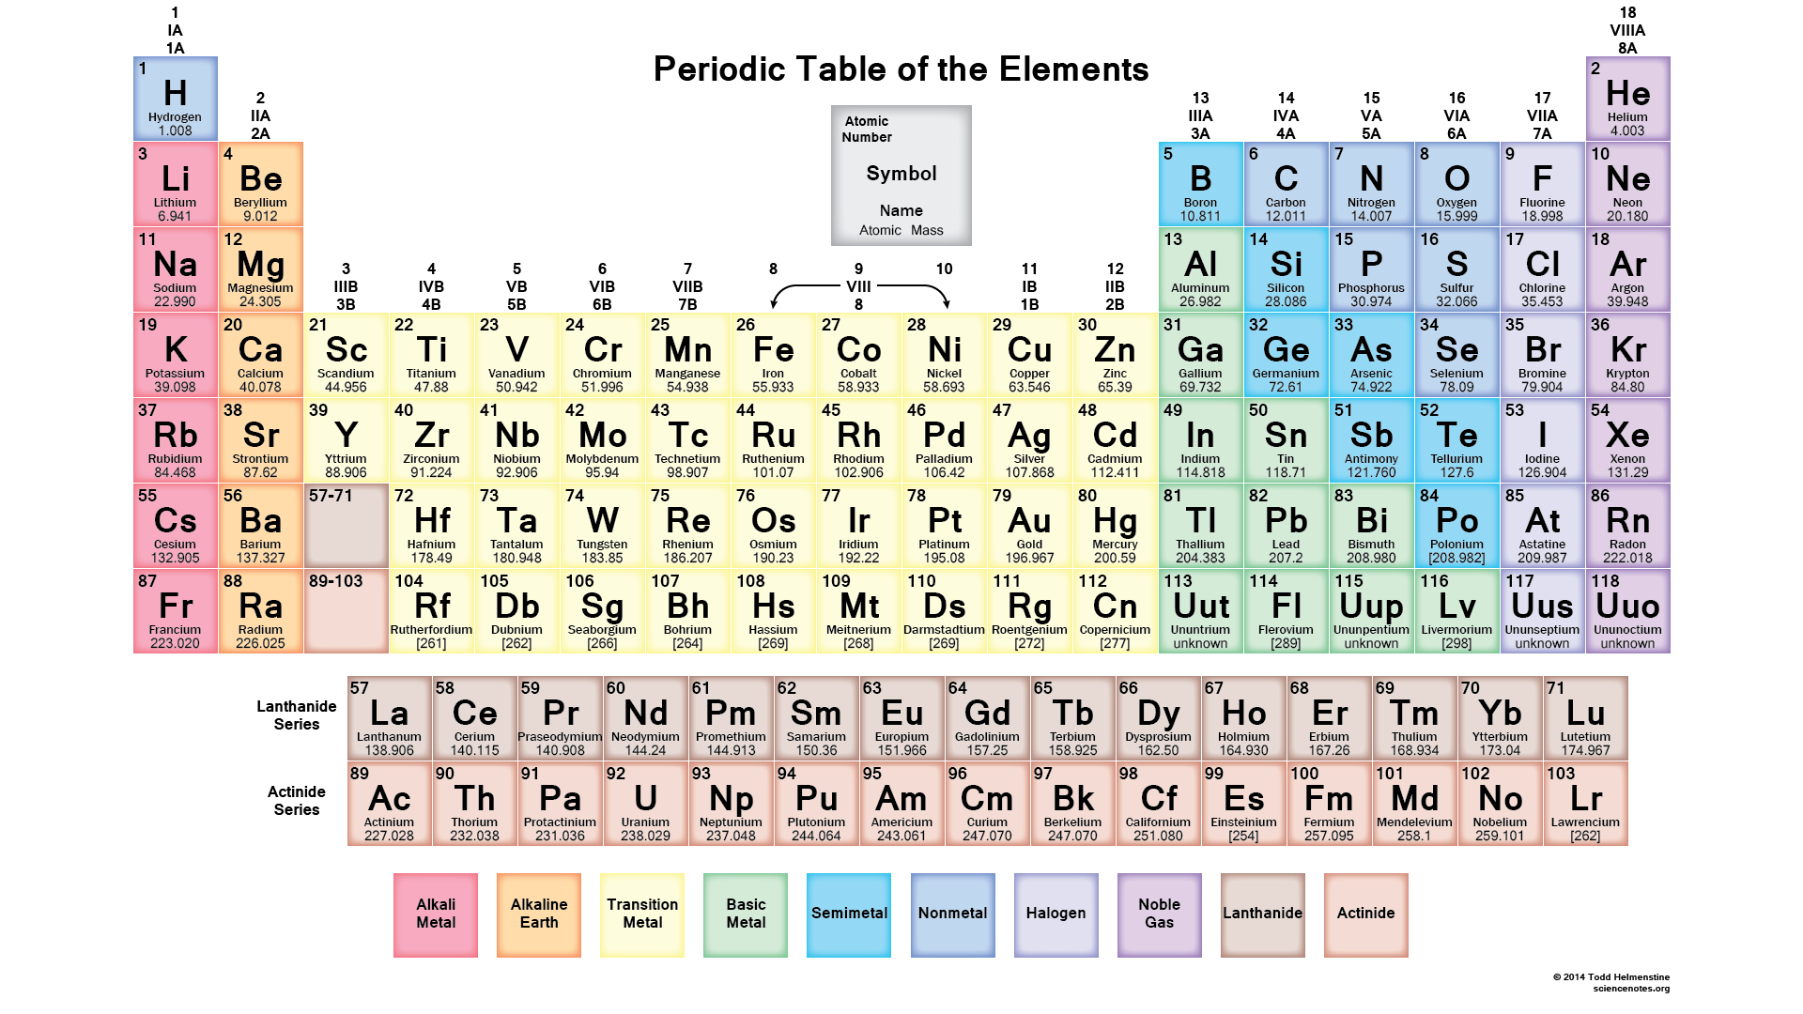
Why is the specific strength of ceramics so much higher?
Notes:
Answer: Bonding – strength of covalent or partially ionic bonds is much higher than most metallic bonds
and ceramics often combine (transition) metal with a much lighter element (like O, N or C)

Slide 9
What are composites?
Composites generally have two parts:
Matrix – light, protective
Reinforcement – strong, stiff
Polymers – most common
Metal – ductile, conductive
Ceramic – high temperature
Carbon
Glass
SiC
Natural fibers (hemp)

Slide 10
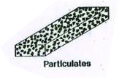
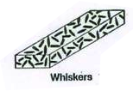
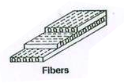
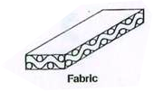
Types of composites
Particle reinforced
Short fiber or whisker reinforced
Continuous fiber

Slide 11
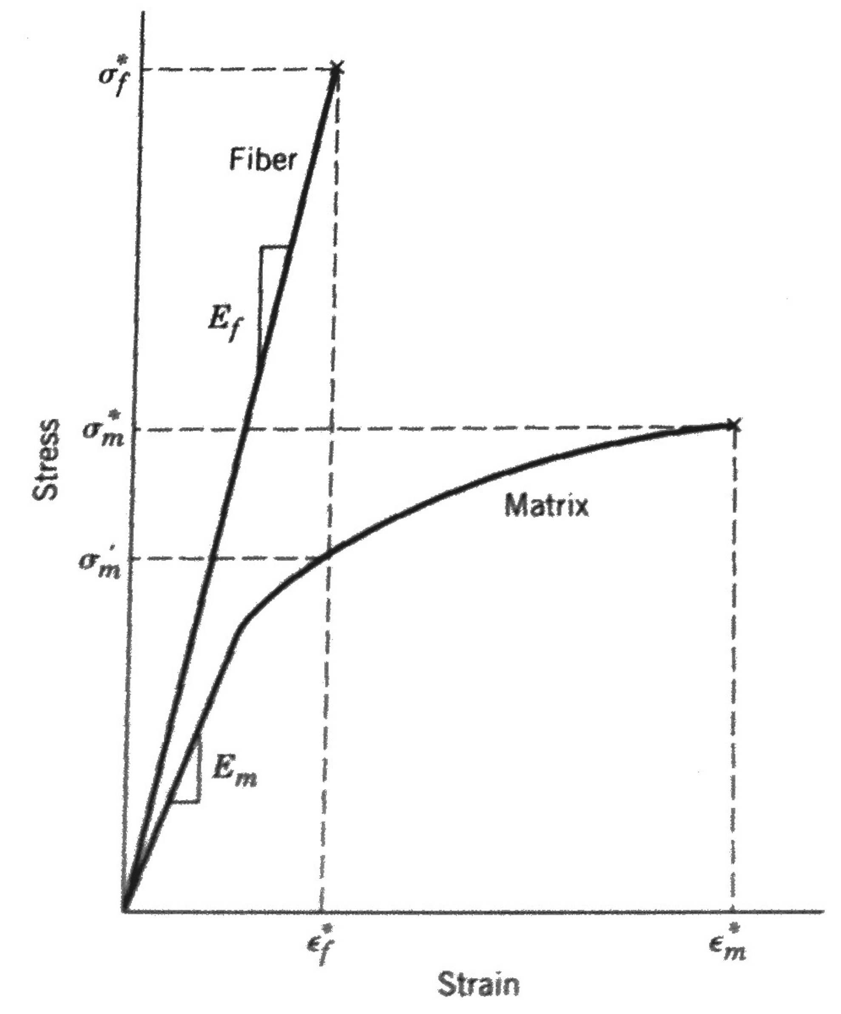
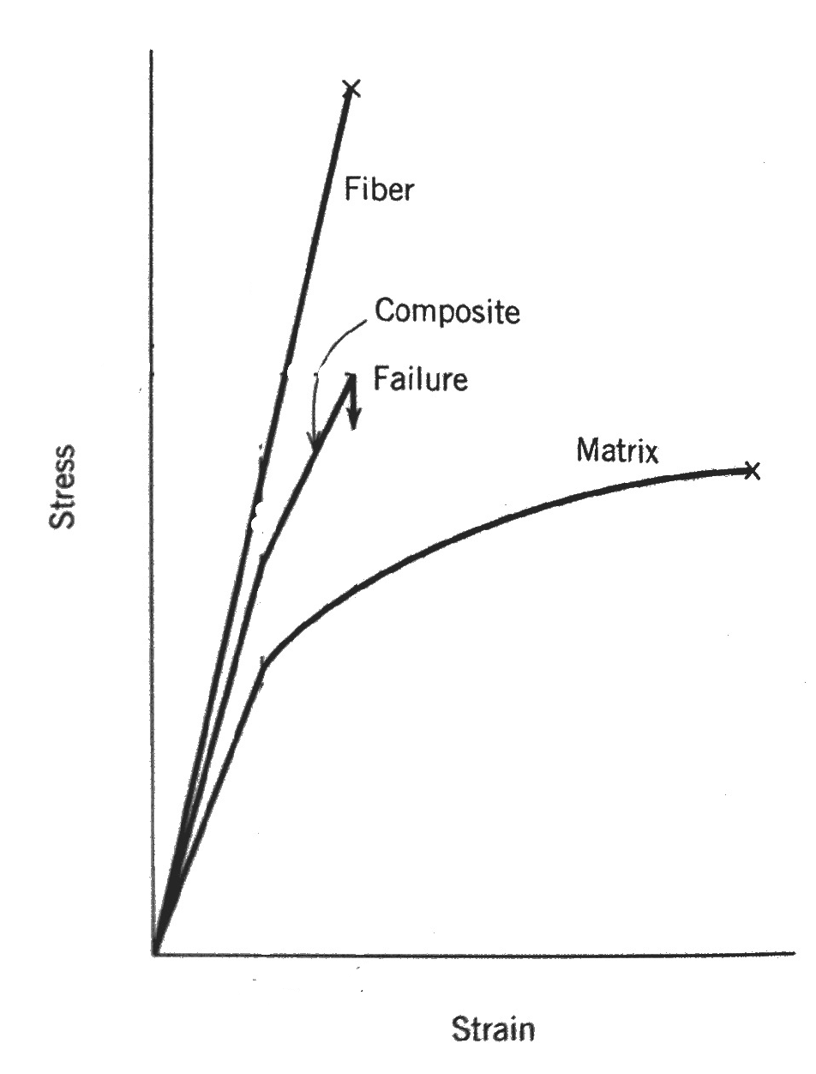
So what’s the actual combined property?

Slide 12
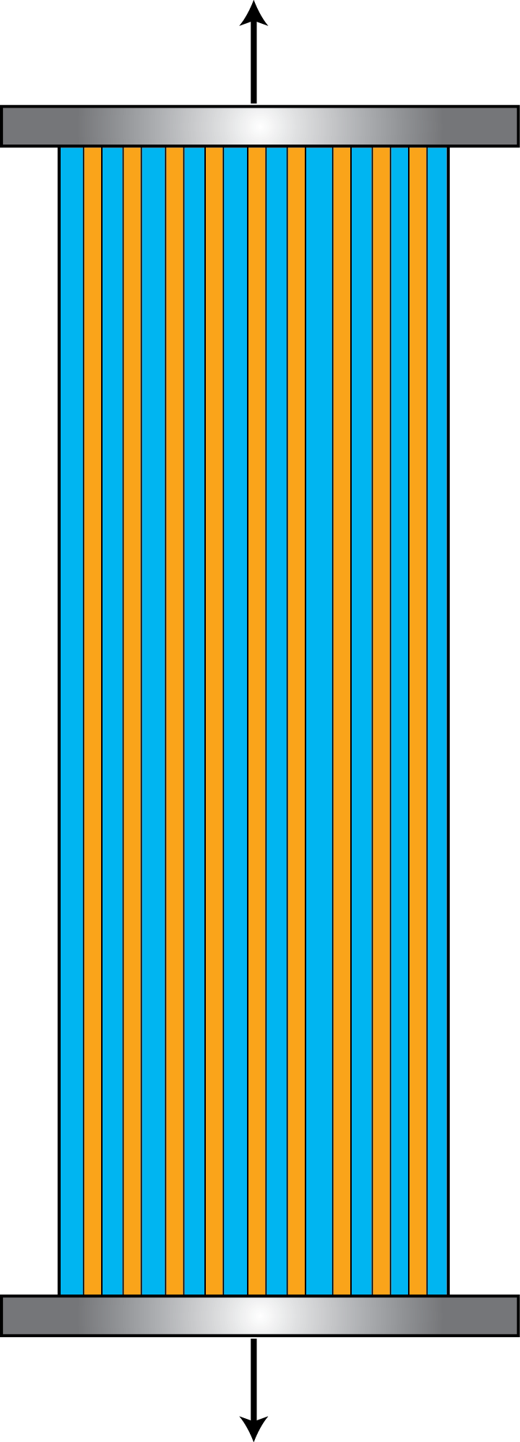
Composite properties depend on fiber type and orientation
Young’s Modulus – E – measure of stiffness:
Notes:
Applied force is distributed between the fibers and the matrix.
A good guess is that the force is distributed proportionally to the volume fraction of fibers. (Vf)

Slide 13
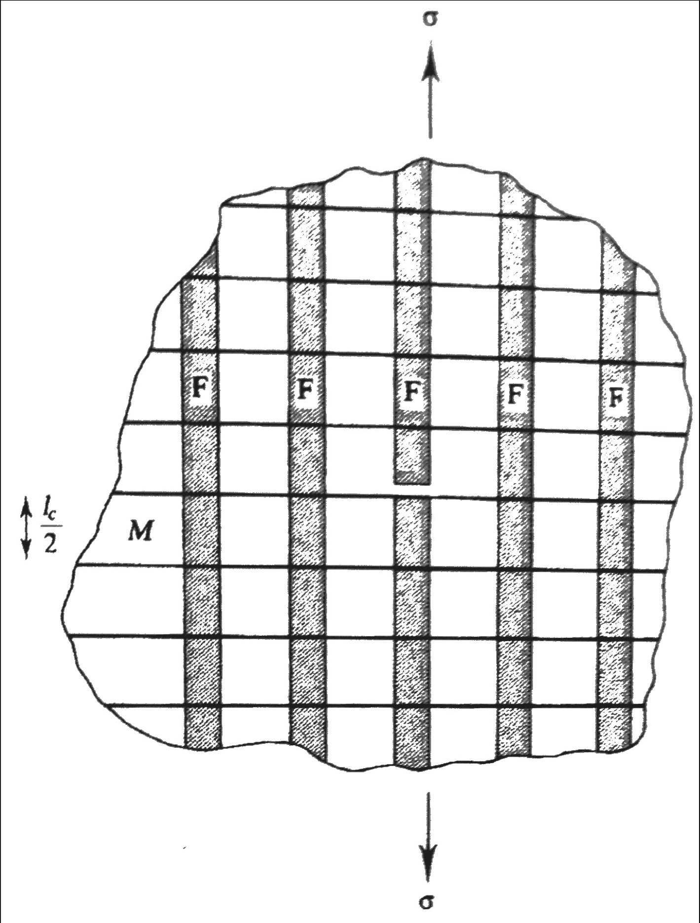
A matrix material can transfer load from one fiber to another
Matrix can transfer load from one fiber to another
Interface is key!!
Notes:
Talk about sizing fibers

Slide 14
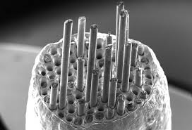
Fiber/matrix interfaces can deflect cracks and dissipate energy
Fiber/matrix interfaces can deflect cracks and dissipate energy

Slide 15
Ex – energy dissipation
https://www.youtube.com/watch?v=JUhopbbHirA

Slide 16
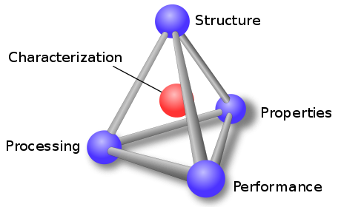
Where do composites fit?

